Slide 1
Hangman Game
Jialong Ke, Yuchen Cao, Zihan Li

Slide 2
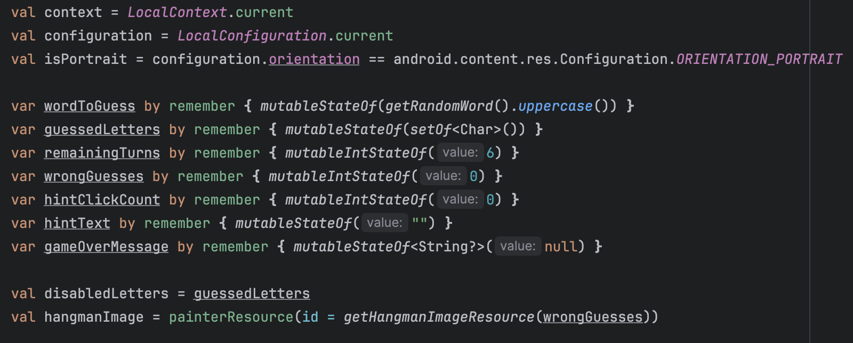
All Variables

Slide 3
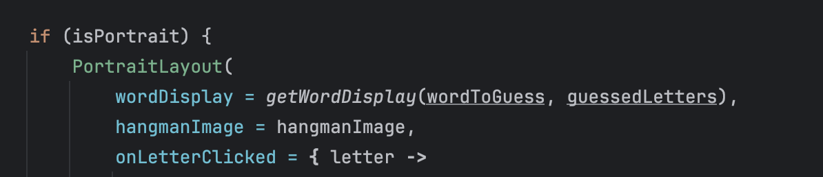
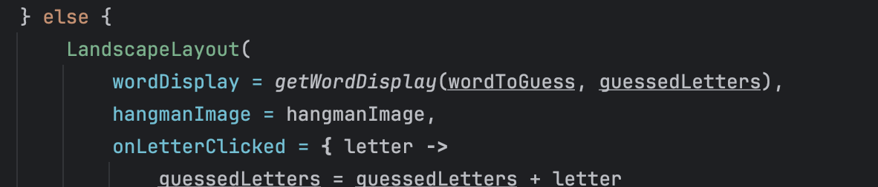
Main Process
Use the isPortrait variable to determine whether the orientation is portrait or landscape, and select the components accordingly to render the screen.

Slide 4
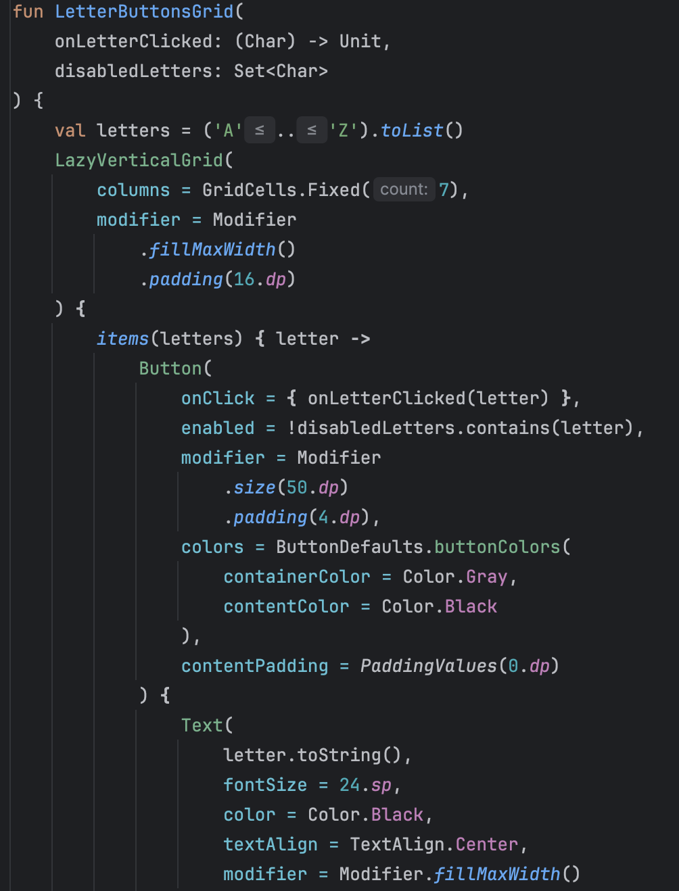
Select Letter
Use LetterButtonsGrid component to display all the letters, where each letter is a button. Two parameters will be passed to the component: a function to handle button clicks and a set of letters that have already been selected. The button's clickable state is determined by whether the current letter is in the set of already selected letters.

Slide 5
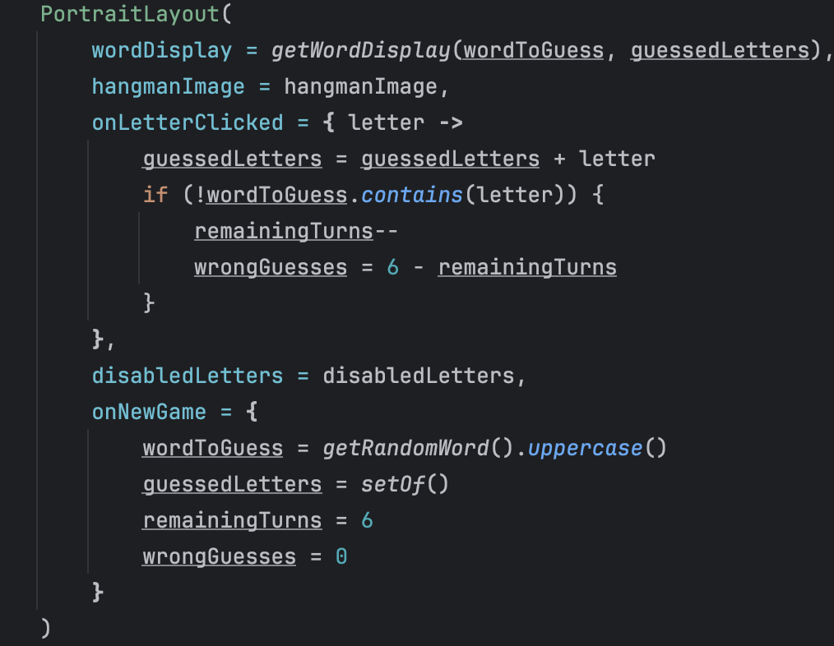
Select Letter
The function for handling Letter clicks was passed to it when the parent component was initially called. For example, in the case of PortraitLayout.

Slide 6
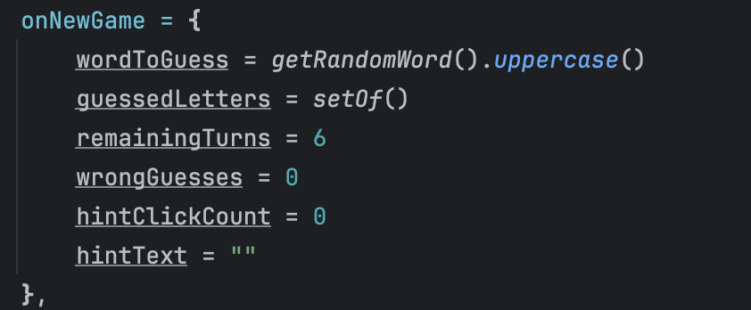
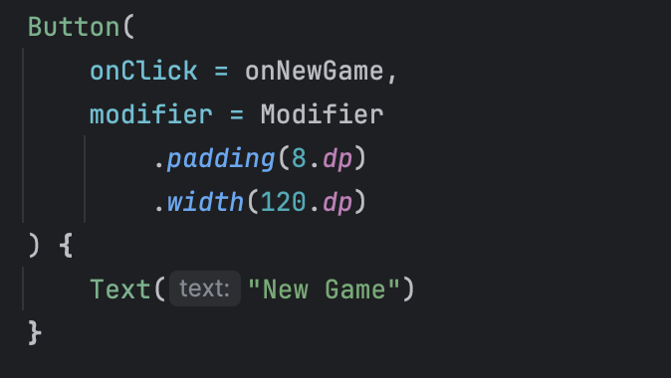
Start New Game
Pass this function to LandscapeLayout and use it on its Button.
All variables were reset in the function.

Slide 7
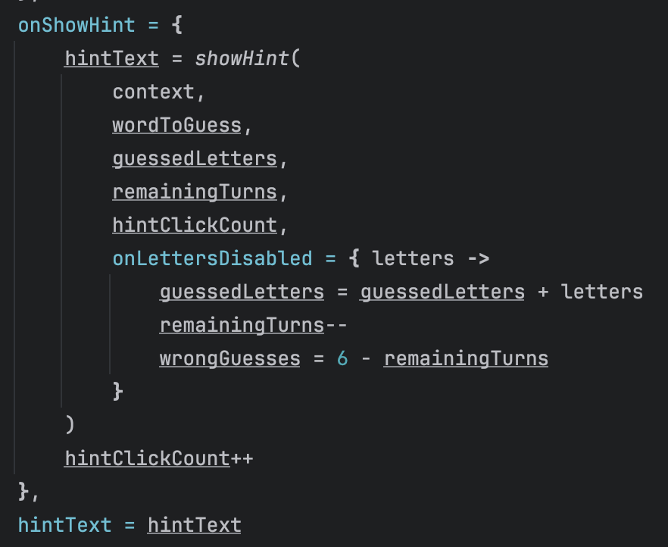
Show Hint
Pass a function and a hintText to LandscapeLayout, and use these parameters inside LandscapeLayout.
The core idea is to call the showHint function each time a Button is clicked, updating the hintText and performing other hint-related actions.

Slide 8
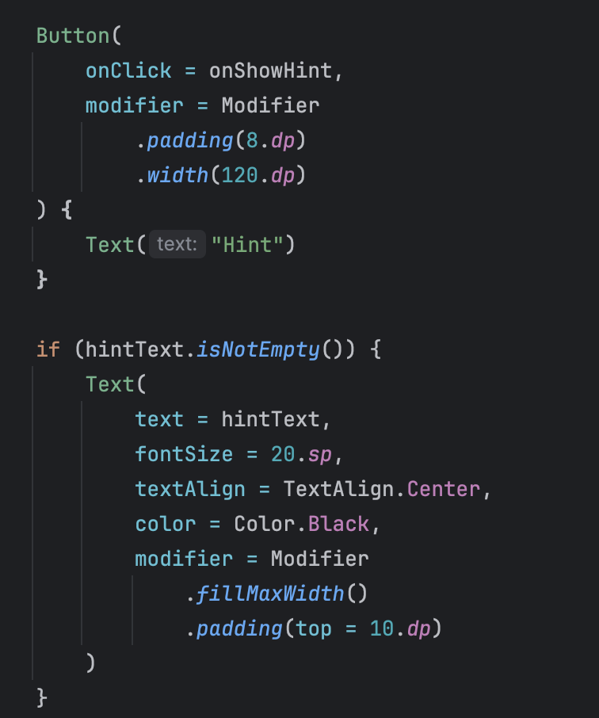
Show Hint
What LandscapeLayout does is use the passed function and show the hint Text.

Slide 9
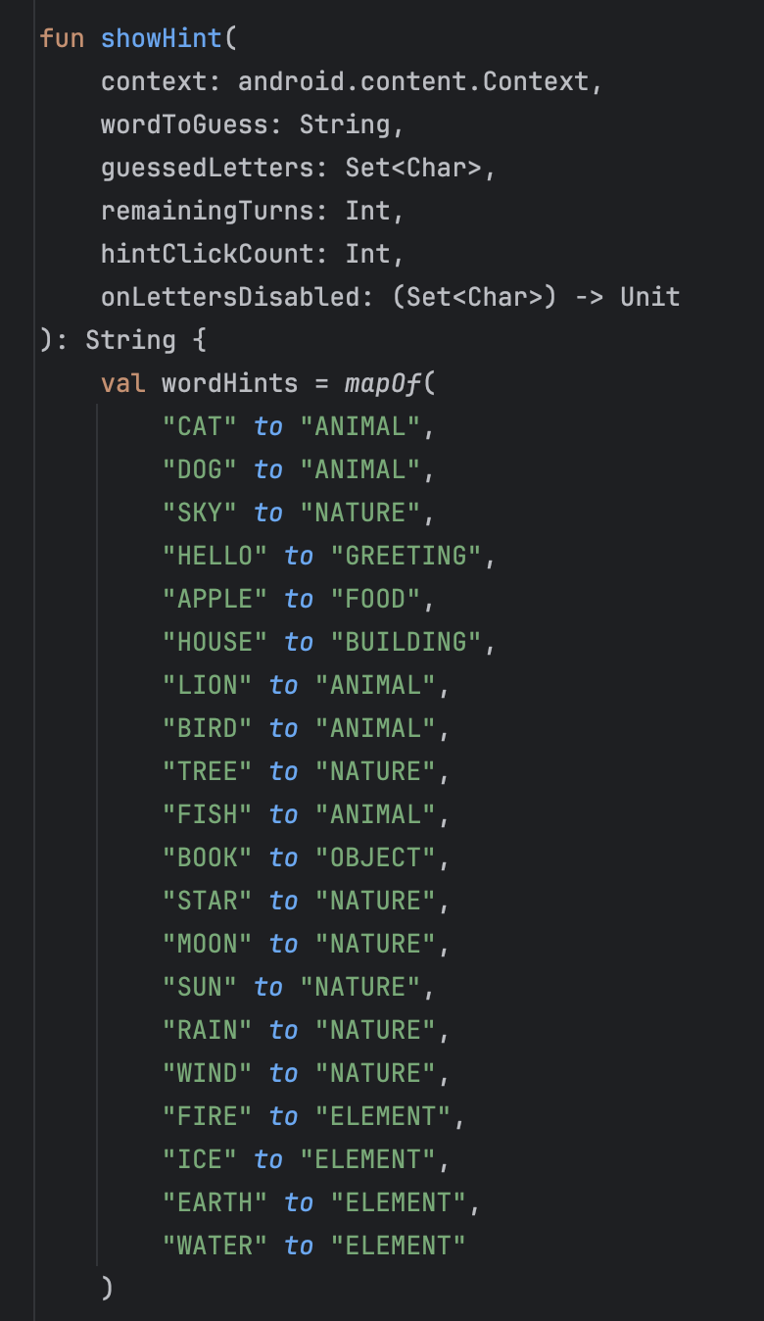
Show Hint
First, we defined a mapping for the hint.

Slide 10
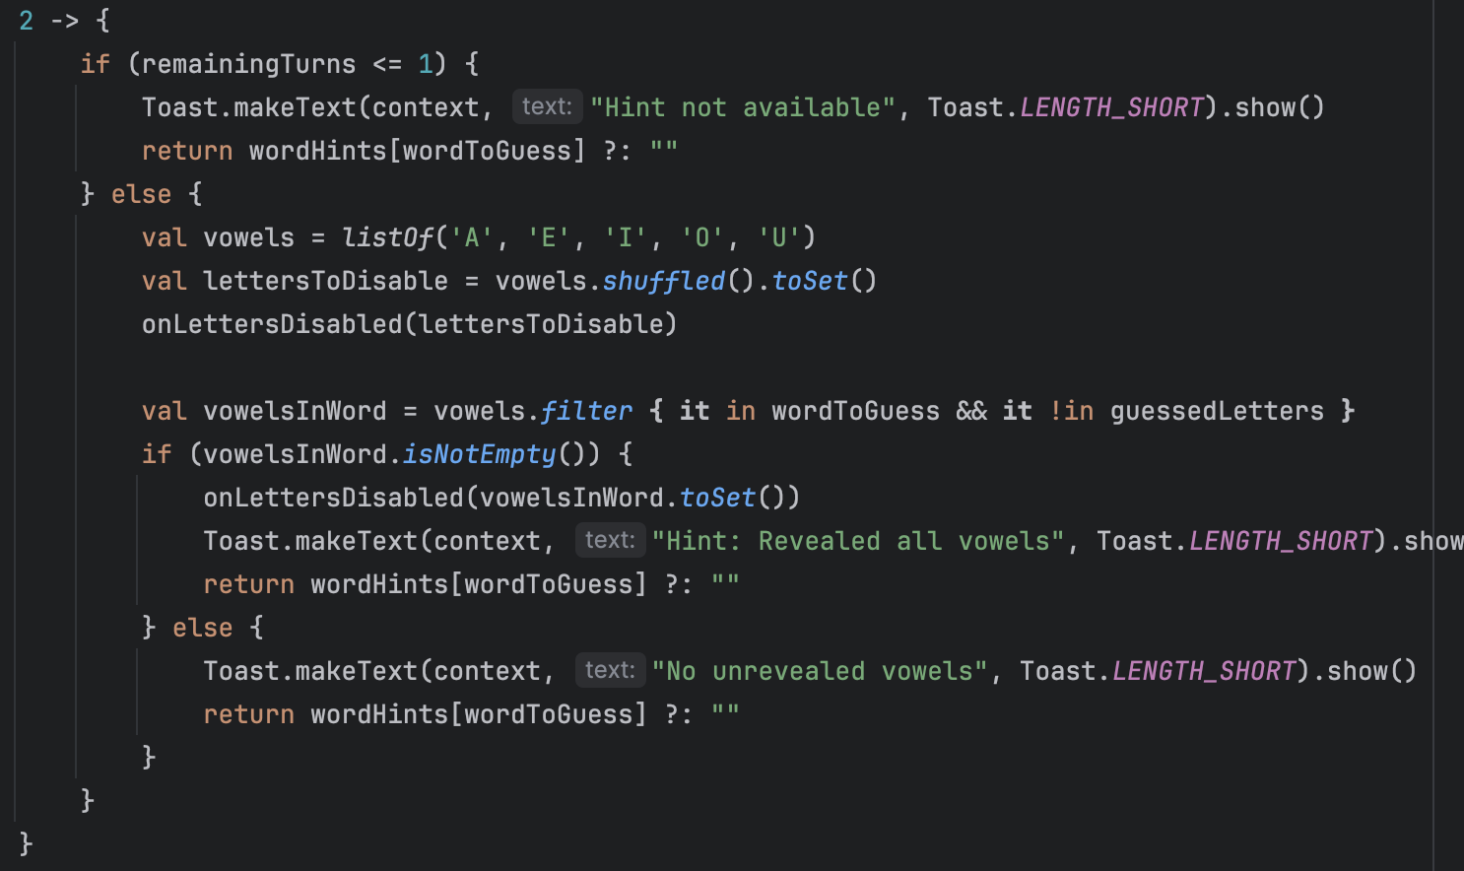
Show Hint
There are 4 types of hints. Let's take the most complex case, when hintCount == 2 (which means the Hint Button is clicked for the third time) as an example.
When the hint click count is 2, first, it checks if the remaining turns are less than or equal to 1. If so, the hint is disabled. Otherwise, all vowel letters are disabled, and then the vowels in the word that haven't been guessed yet are revealed.

Slide 11
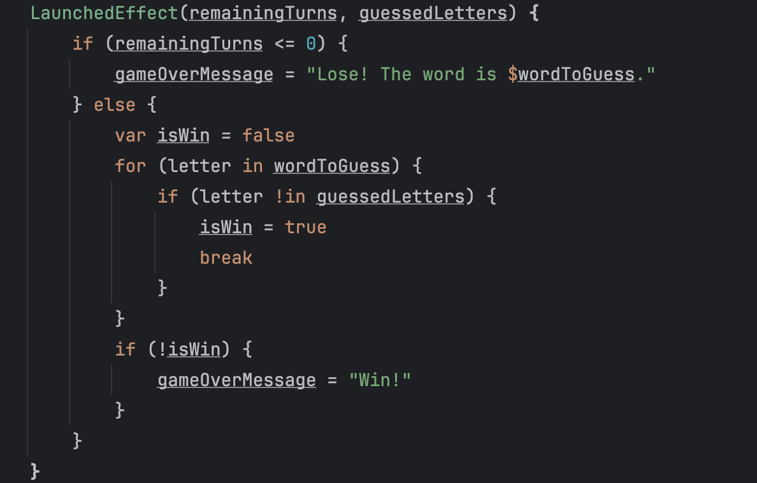
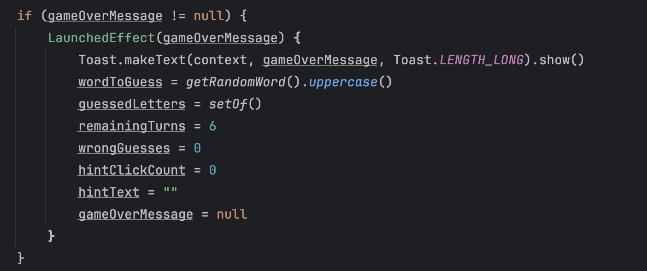
Check Game Over
We use LaunchedEffect to monitor whether the game has ended. If the game is over, gameOverMessage will no longer be null, and then this LaunchedEffect will be triggered, resetting all values.

Slide 12
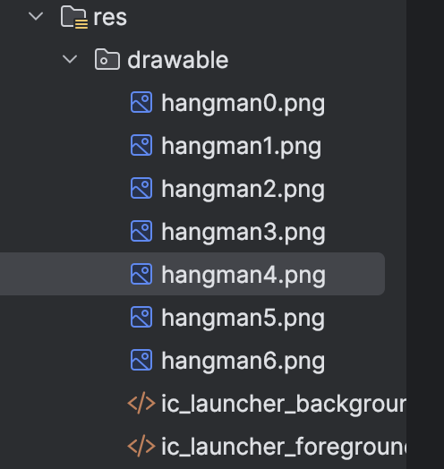
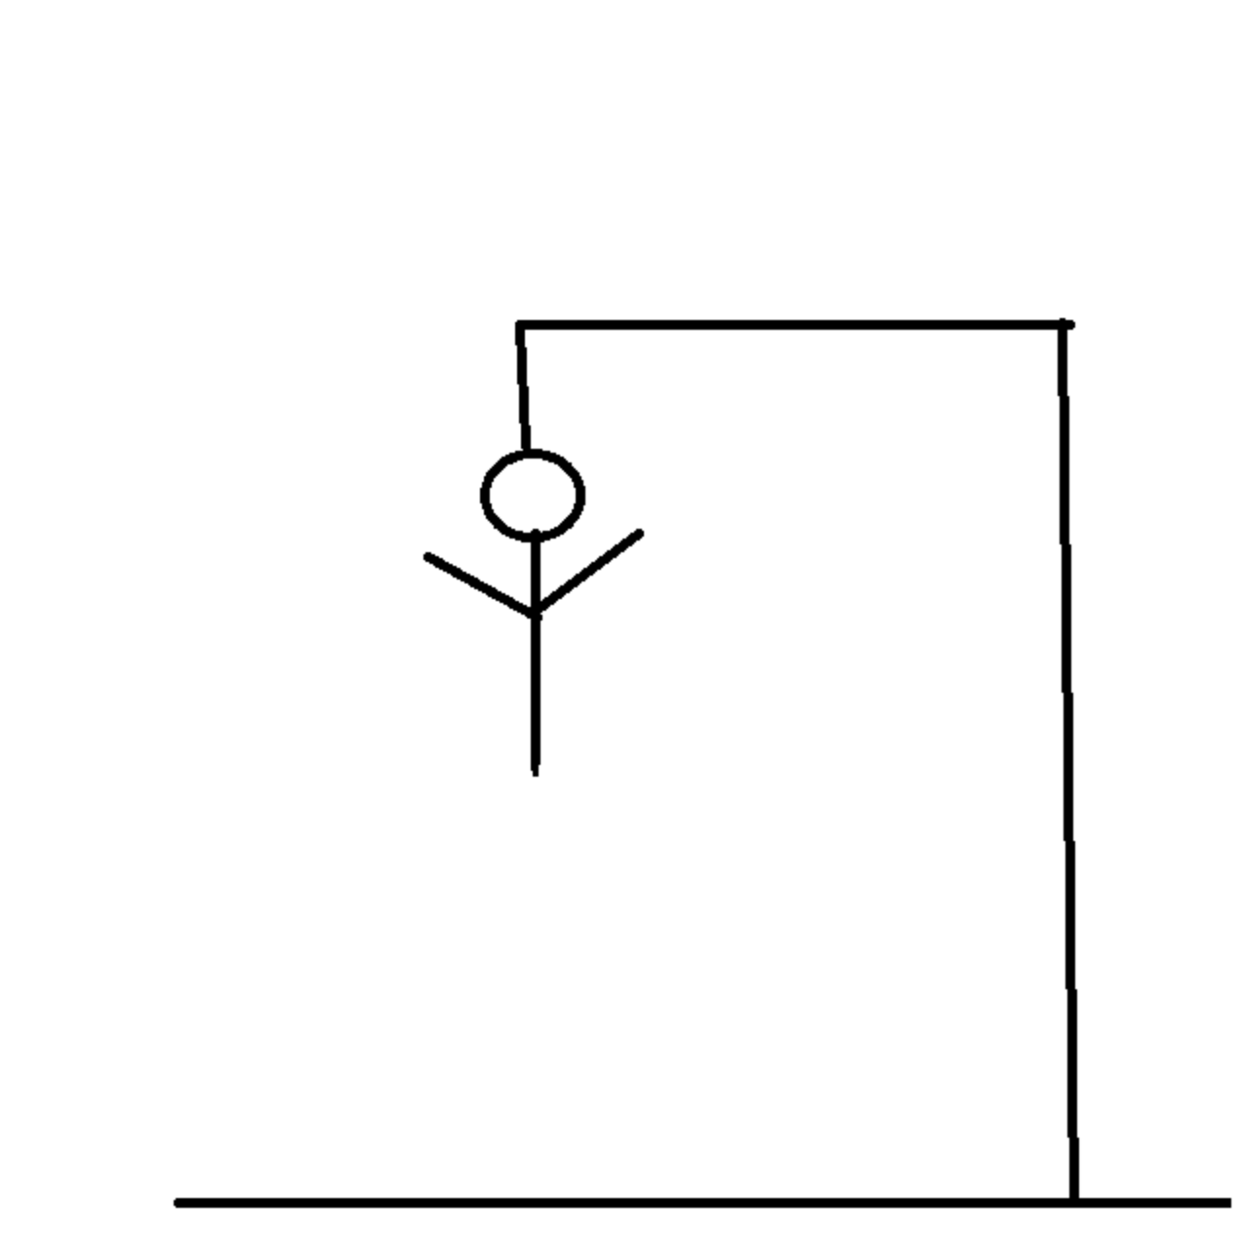
Six States

